Slide 1



Technoholics

Slide 2
The Dream Team
Hasnain Akhtar
Algorithms
Michael Gottwald
Python
David Kuehnert
Computer Vision
Vivian Lin
Project Management
Olivia Luttazi
VHDL
XiXiao Yue
GUI

Slide 3
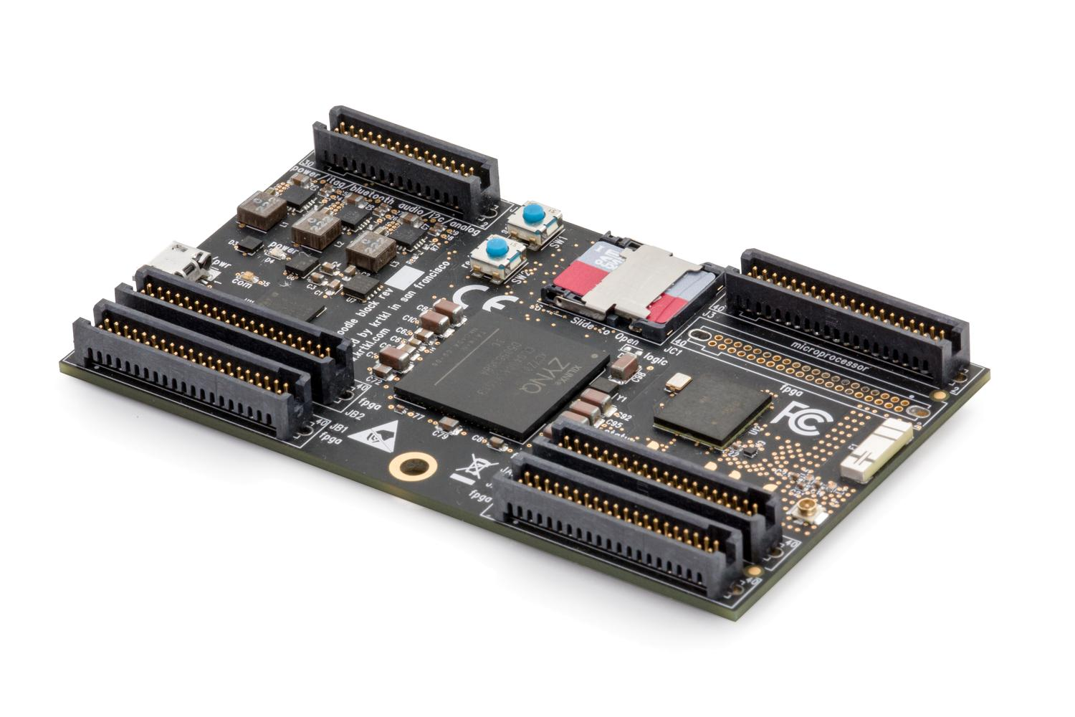
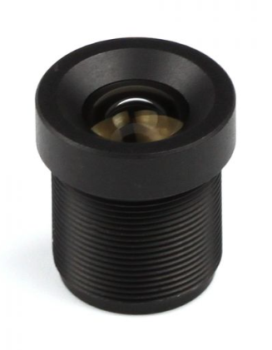
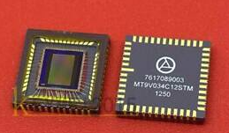
Project Overview
Creating a software to detect tennis ball
Cameras
Snickerdoodle
April tags
Analysis
Visualization

Slide 4
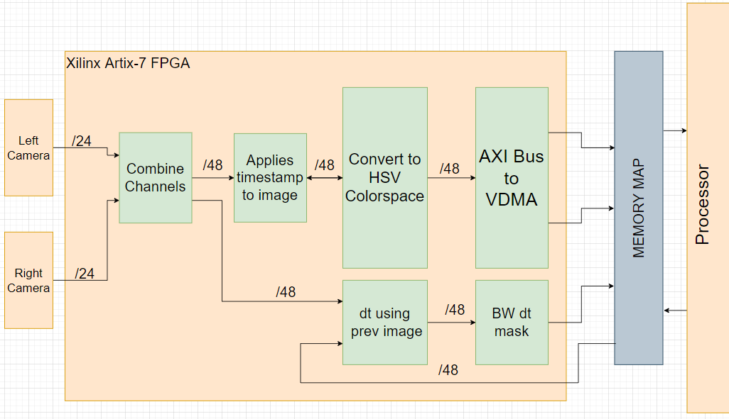
FPGA Block Diagram

Slide 5

Setting Up for Success
Due to constraints on hardware during PDR, we developed a PYQT GUI using Model, View, ViewModel (MVVM) design principles
This allowed us to test out various color spacing, along with being able to see the pros and cons of each one
The resulting GUI allowed us to fast track our back end development when it came time to access the snicker doodle boards

Slide 6
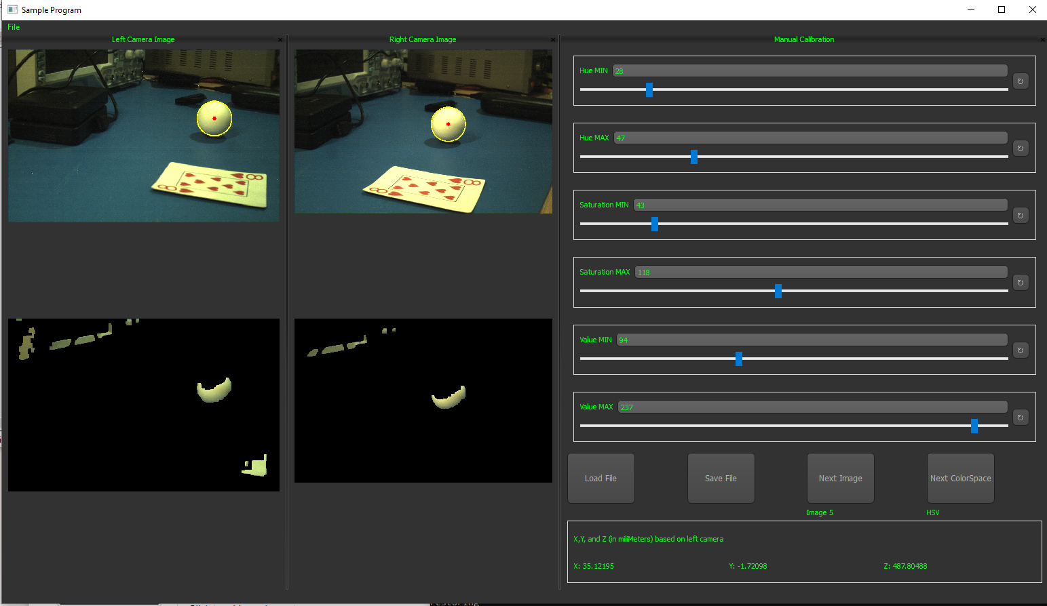
Manual Calibration

Slide 7
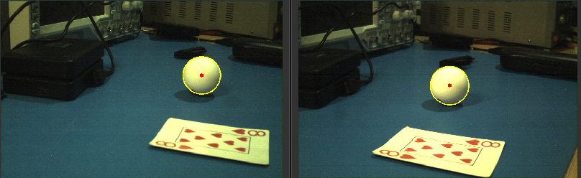
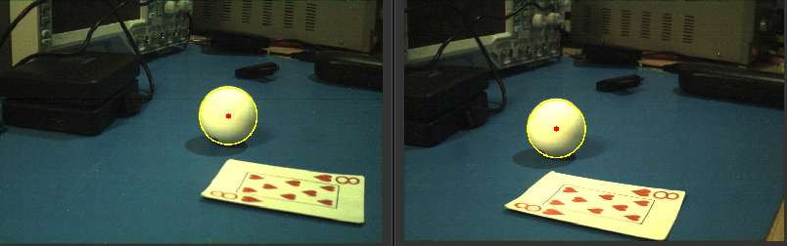
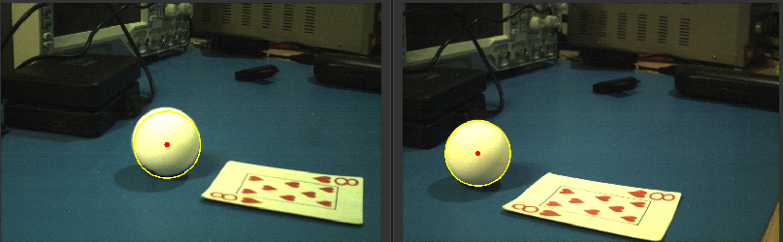
Cycling through the HSV color space
Using the next image button, we can easily cycle through images saved on file to test the manual calibration settings

Slide 8
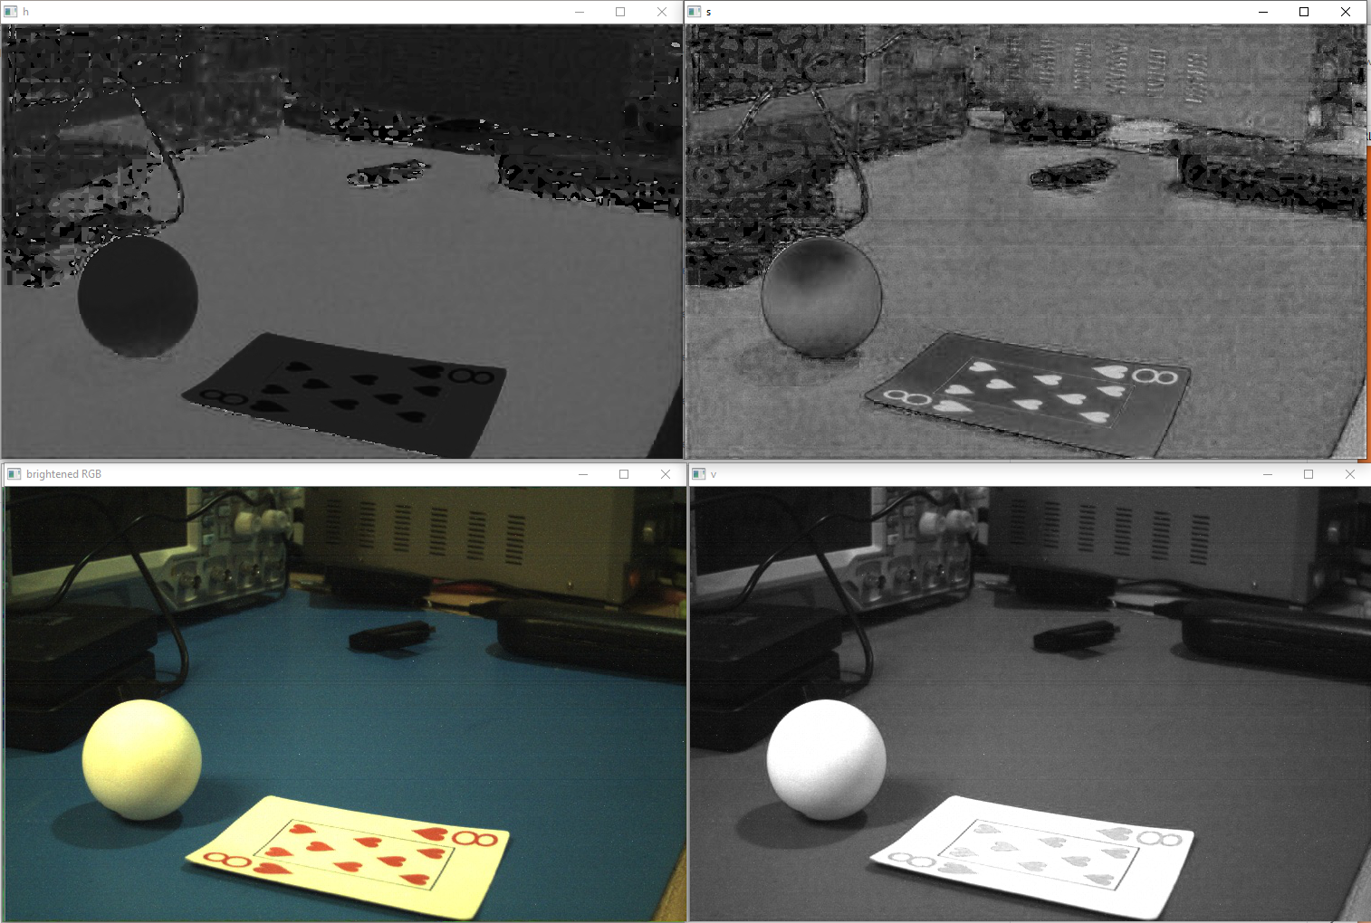
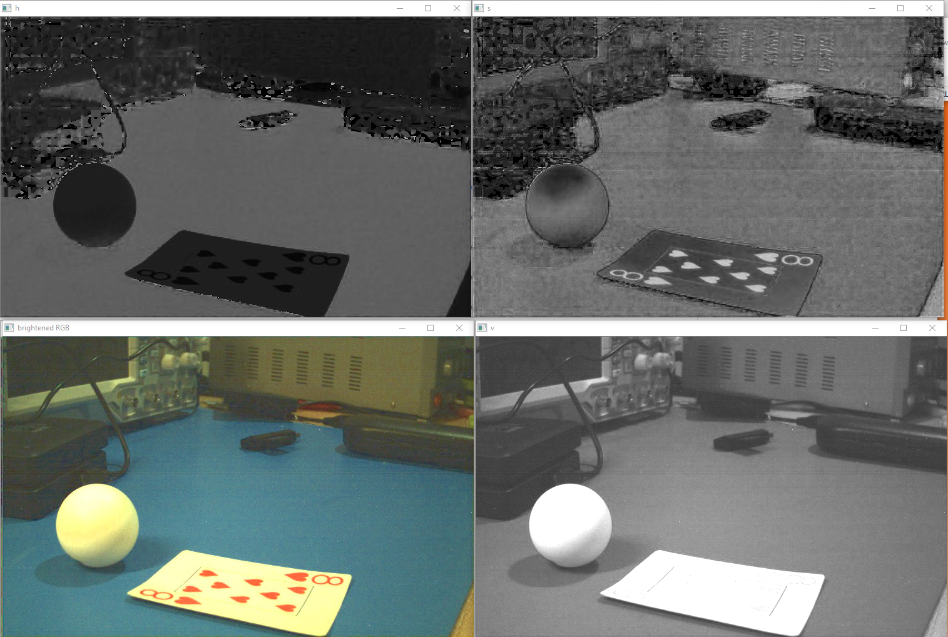
Making the Color Space Decision
Untouched
Brightened

Slide 9
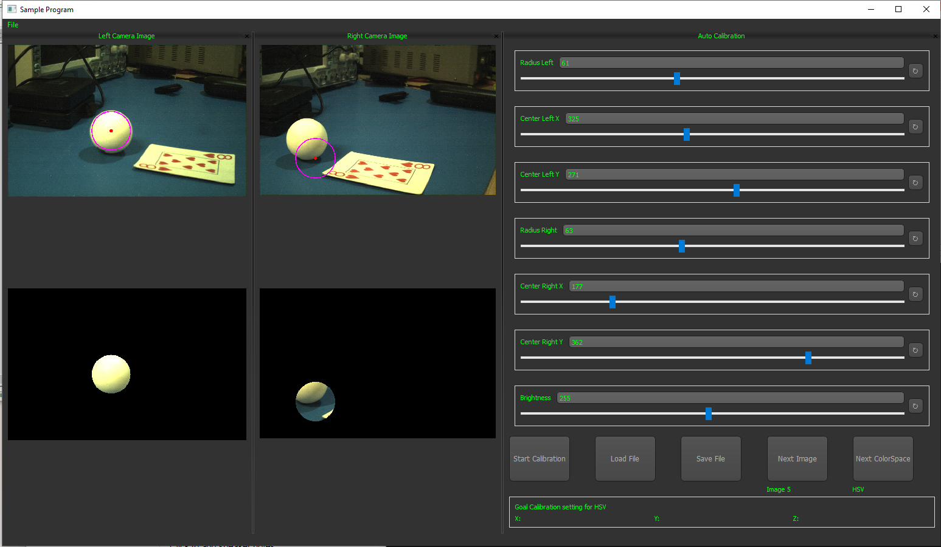
Auto Calibration

Slide 10
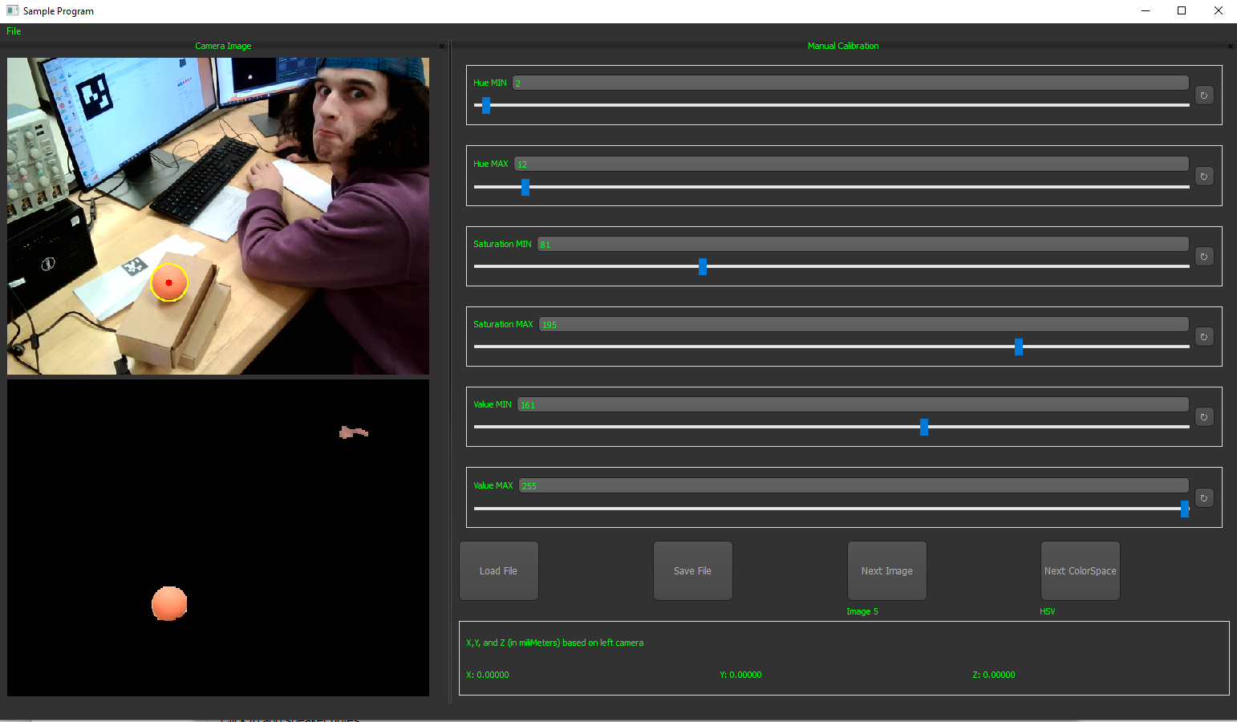
More Testing!
Now that image files could be read, we modified the application to read a serial webcam for real time testing
Manually Tuned

Slide 11
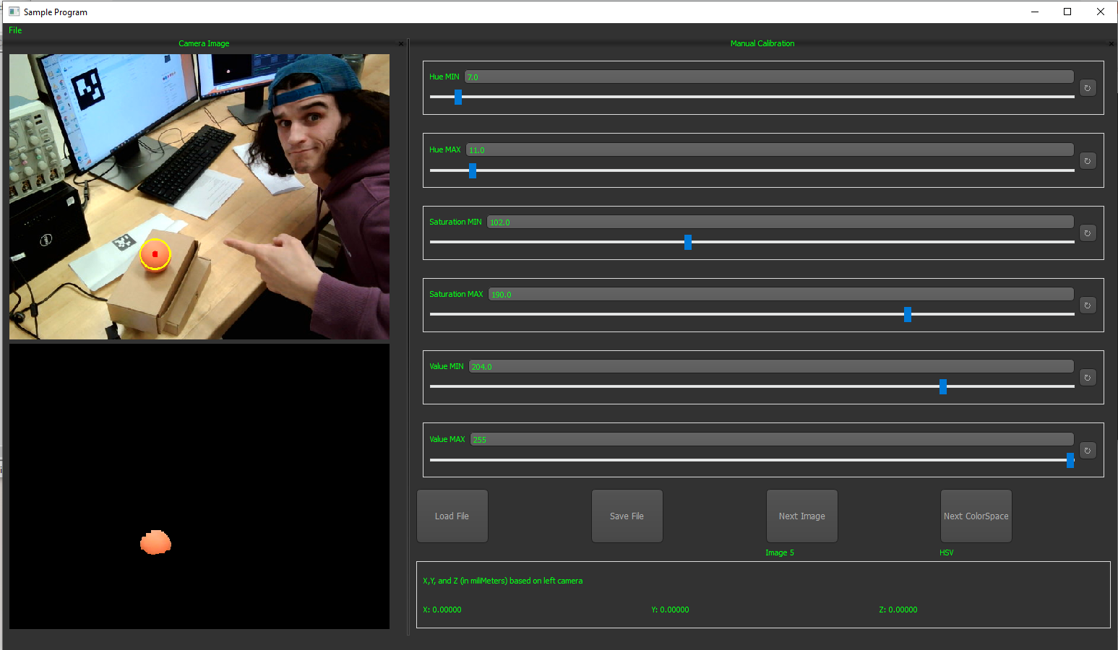
Results from Auto Calibration
Using the highlighting feature in auto calibration mode, the results can be saved to a .txt
From here we can go back to manual calibration to verify the results
Auto Tuned

Slide 12
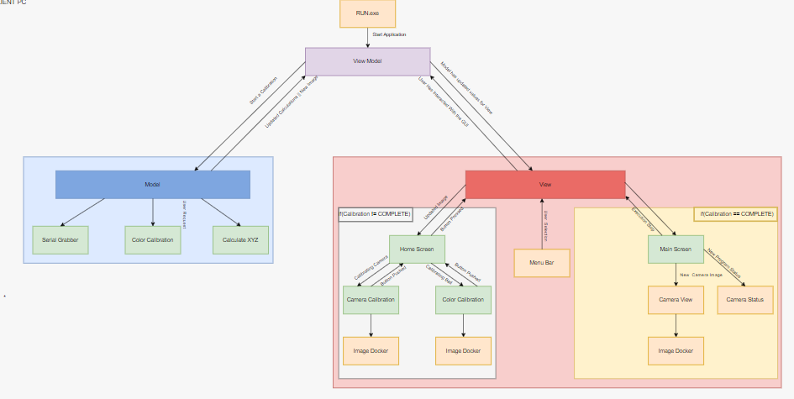
The Original GUI Model

Slide 13
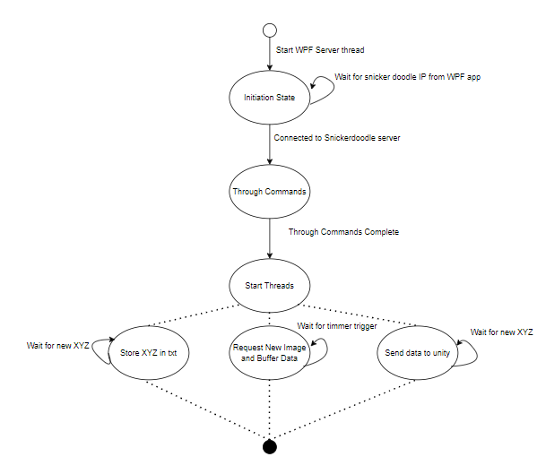
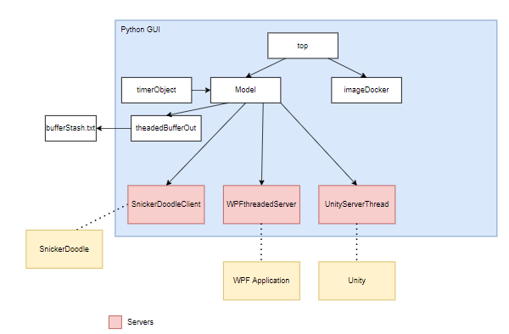
Python GUI Overview

Slide 14
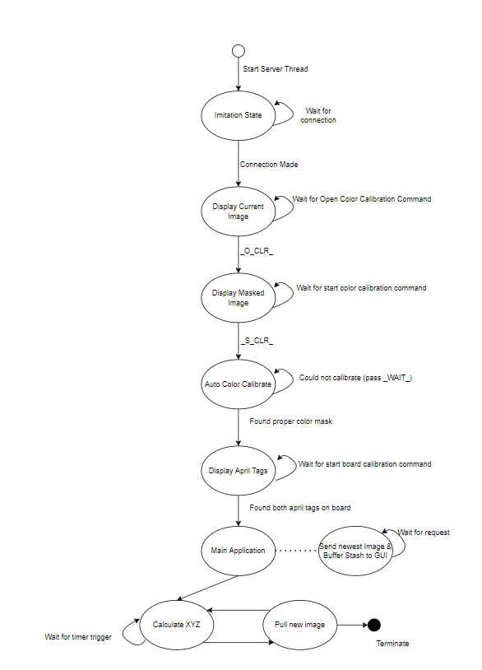
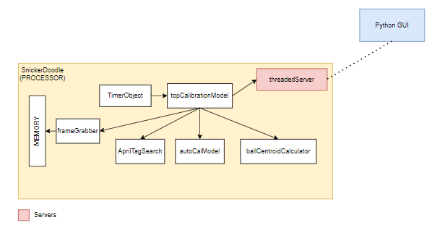
SnickerDoodle Processor Overview

Slide 15
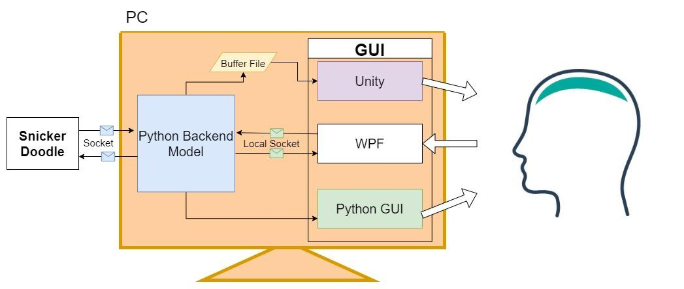
Upper-end Client Modulation

Slide 16
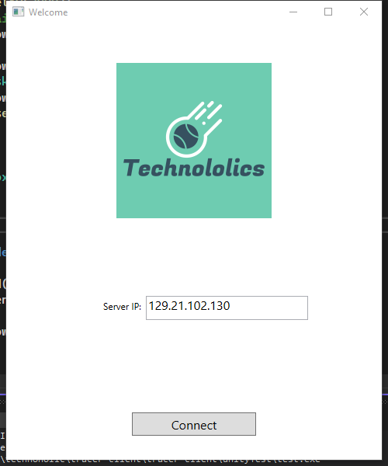
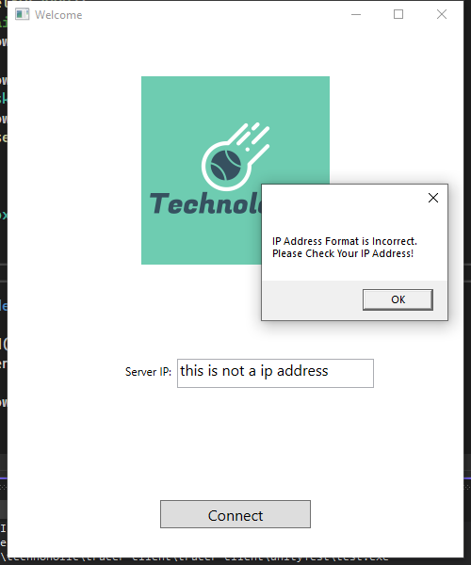
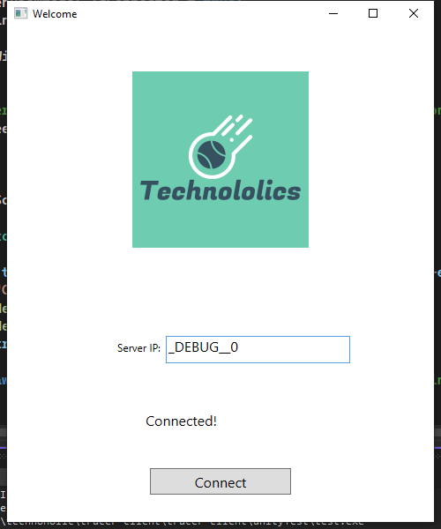
Camera Connection

Slide 17
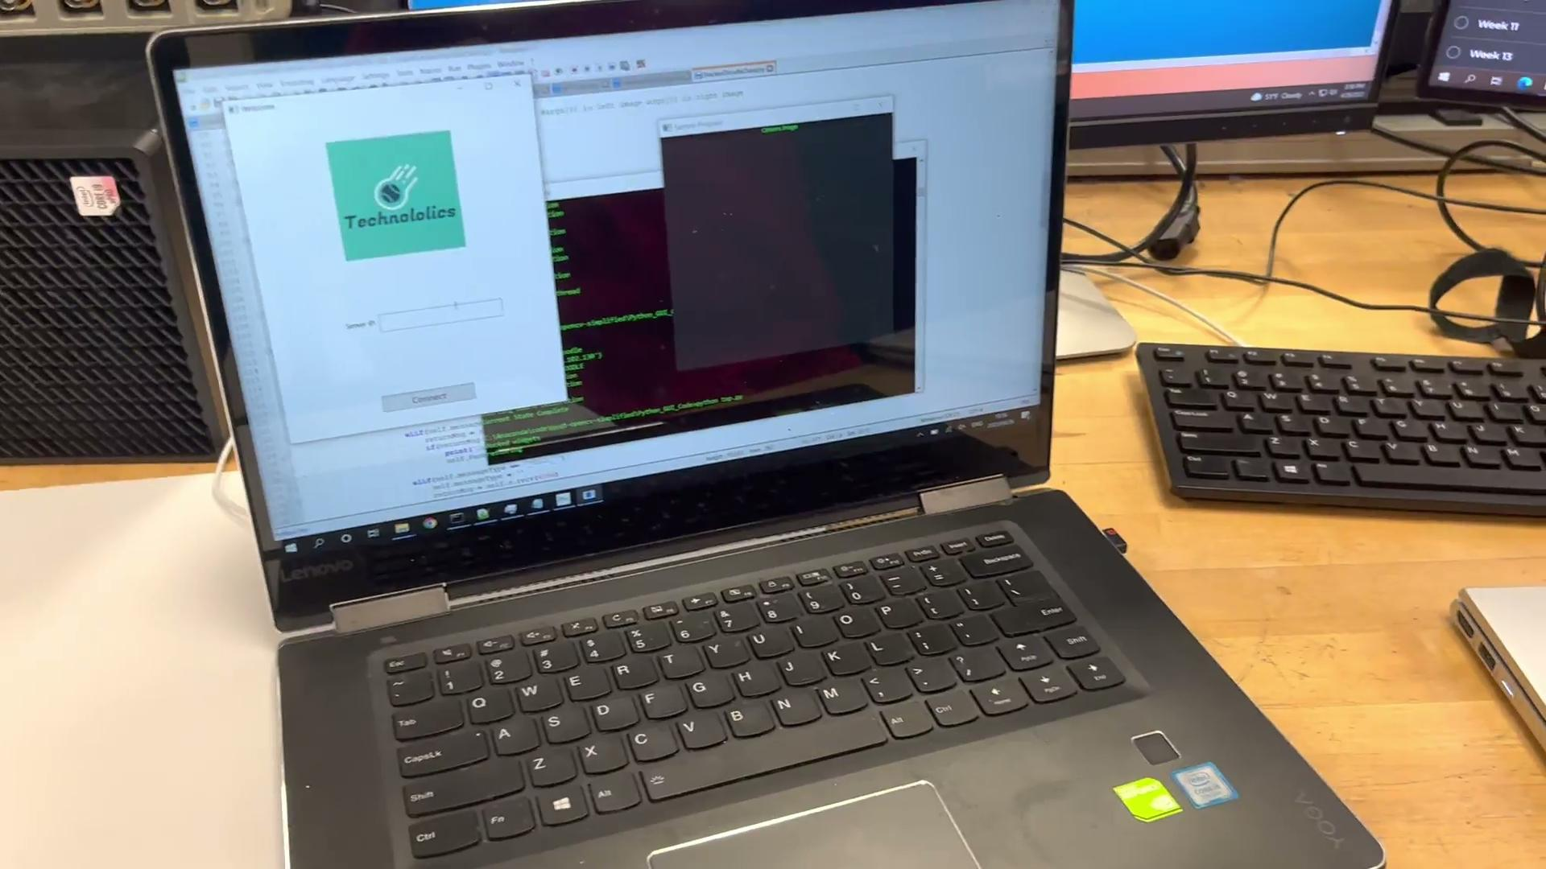
WPF Demo

Slide 18
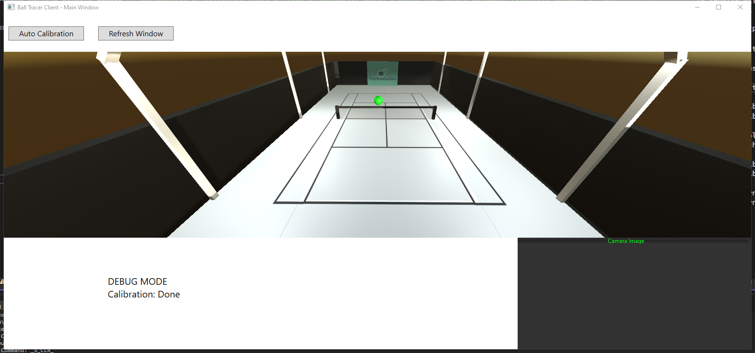
Main Window

Slide 19
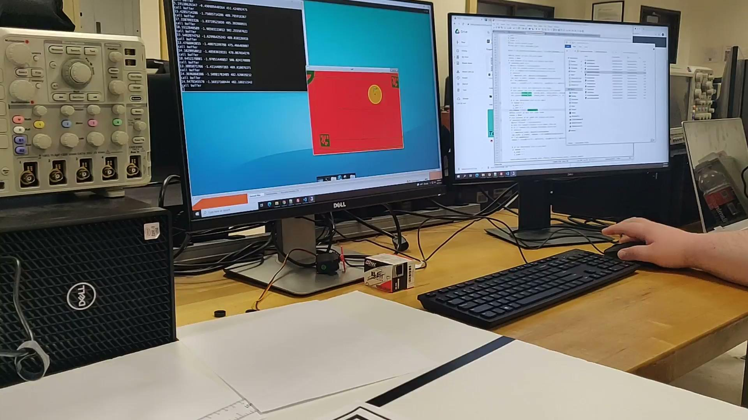
Masking - Demo

Slide 20
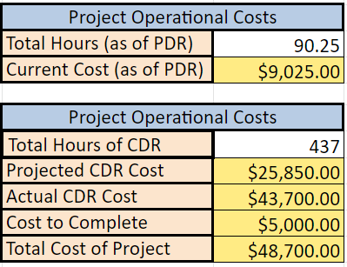
Camera Motion Errors
Camera detect motion of ball
April Tag and camera set onto a fix location
Live-Masking working properly
Issues
Movement of camera alter calculation
Connection to the camera do not always work
Older version of PyQt causes issues with code
Expected implementation time: 20 hours
Notes:
Need to add projected CDR cost
cost to complete
Total cost of Project

Slide 21
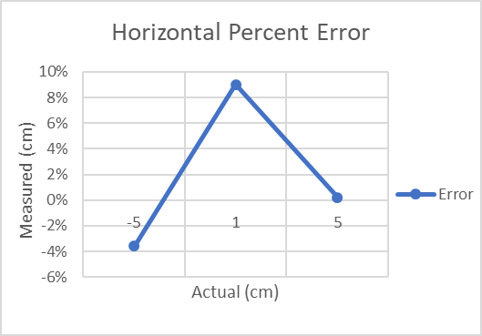
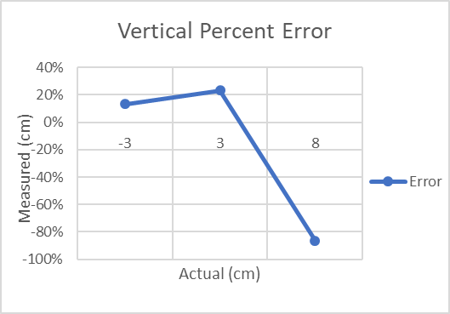
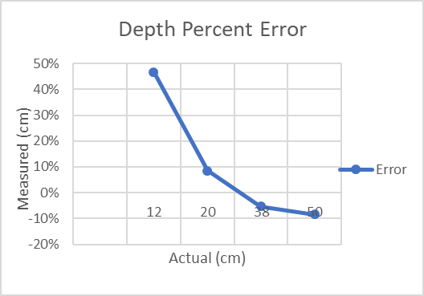
System Accuracy
All 3 dimensions were tested for overall accuracy
X (horizontal), Y (vertical), Z (depth)
The ball was held at various offsets and the X,Y,Z coordinates recorded
These were compared against actual distance values
Notes:
Need to add projected CDR cost
cost to complete
Total cost of Project

Slide 22
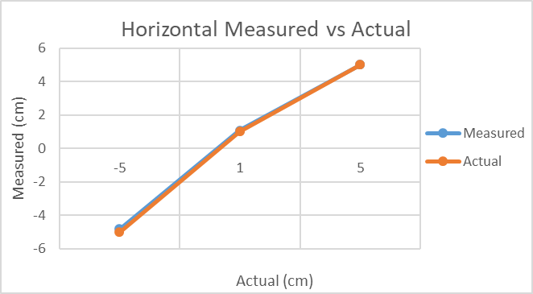
System Accuracy
Horizontal accuracy was measured at -5, 1, and 5cm
The percent error stayed with [9]% across the 3 test points
Notes:
Need to add projected CDR cost
cost to complete
Total cost of Project

Slide 23
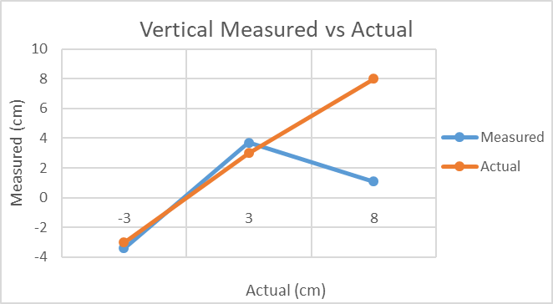
System Accuracy
Vertical accuracy was measured at -3, 3, and 8cm
The percent error stayed with [8]% across the 3 test points
Notes:
Need to add projected CDR cost
cost to complete
Total cost of Project

Slide 24
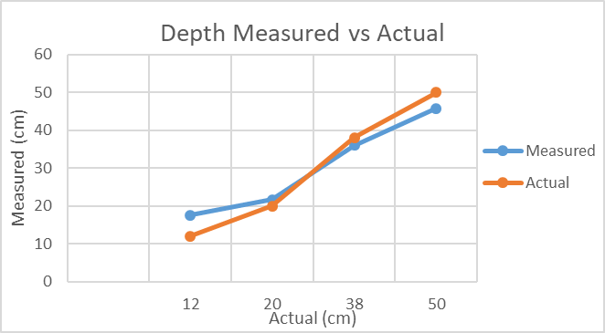
System Accuracy
Depth accuracy was measured at 15, 30, 45 and 60cm
The depth measurement was poor close to the camera, but improved as the ball was moved away.
Notes:
Need to add projected CDR cost
cost to complete
Total cost of Project

Slide 25
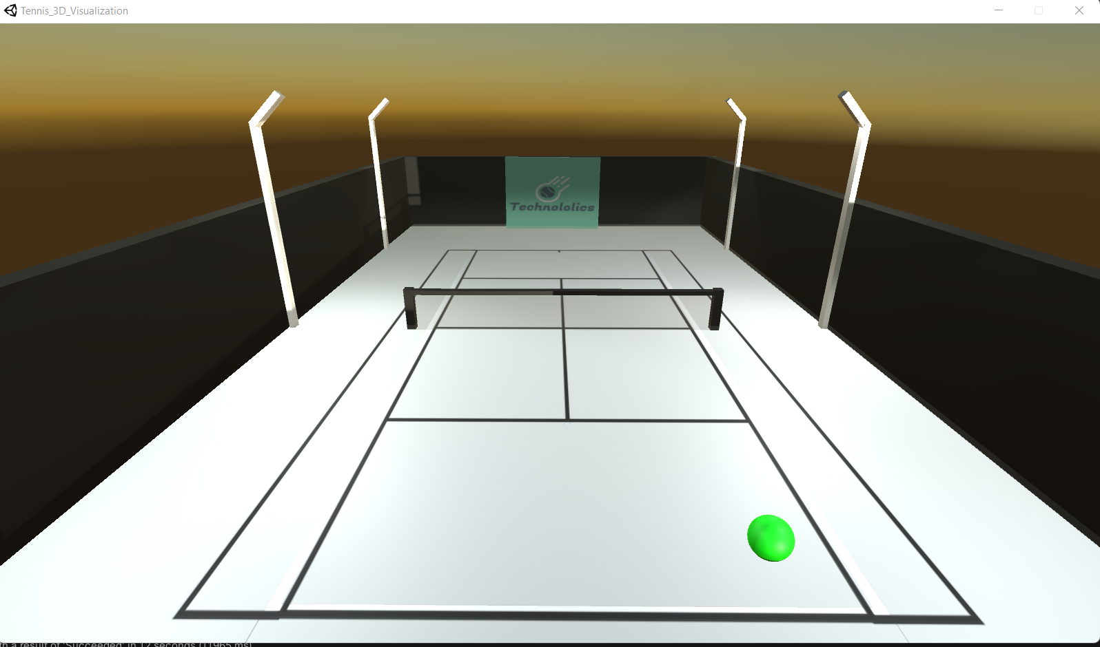
Unity - UI
Notes:
Points to discuss:
UI Layout
Collision detection overlays
LEDs
Evening/Night time to keep the theme of hsv colorspace and portray our night functionality

Slide 26

In Bounds Visualization
Notes:
to show the functionality of the unity
Generation of an actual ball projection
infinite loop run from the client side
talk about the buffer stash and how that was discarded as a decision:

Slide 27
Out Bounds Visualization

Slide 28
Unity Updates for the Future
Add X,Y,Z + change in time functionality
Connect real-time values to server instead of buffer queue
Make sure scale of field / real-time values are correct
Expected time necessary: 12 Hours
Notes:
snickerdoodle latency issues - wifi module latency is 500ms
file inside snickerdoodle
harder to parse the values/transfer over to the UI
talk about real time data send from the data image threaded server - something to be worked on in the future.

Slide 29
Project Outcomes
Successes:
System successfully finds and tracks the ball across the course
Fleshed out interconnectivity system
Easy to use GUI
All major requirements were met
Pain Points:
Low FPS & response times due to network latency & rendering
Has issues in high light environments
Had some issues with version control
Code could use refactoring in some places
Server Socket Connections are not all functioning
Expected time to fix integration issues: 18 Hours

Slide 30
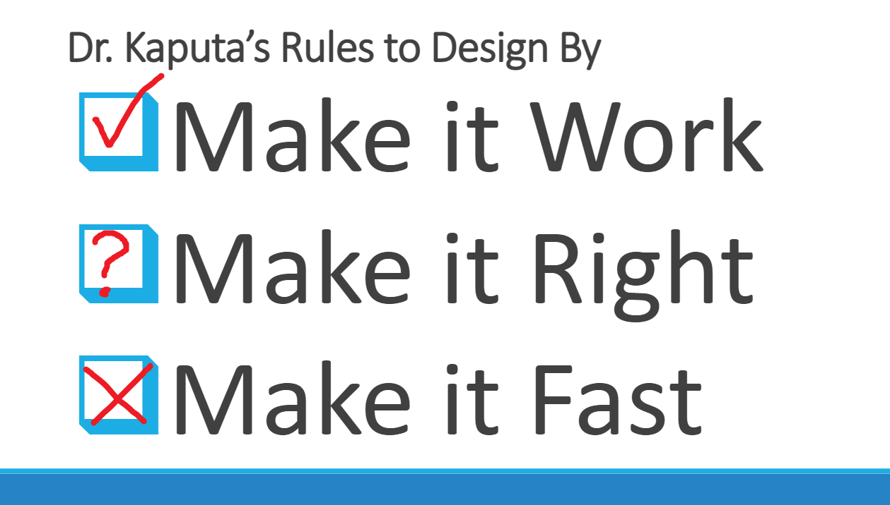
Project Outcomes

Slide 31



Project Management
Communication
Discord
Weekly Meeting Sunday
Updating Tasks and Hours
Google Drive
Microsoft Excel

Slide 32
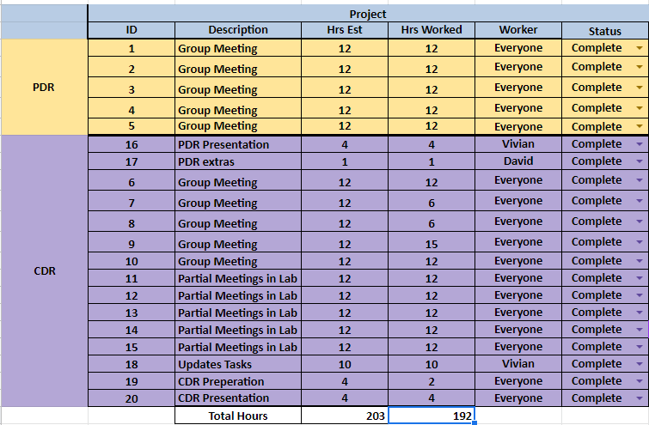
Task and Hours (Weekly Meeting)

Slide 33
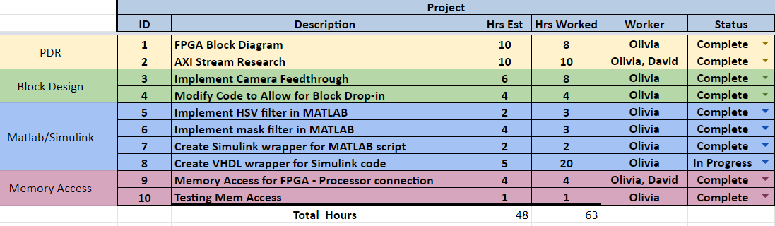
Task and Hours (FPGA)

Slide 34
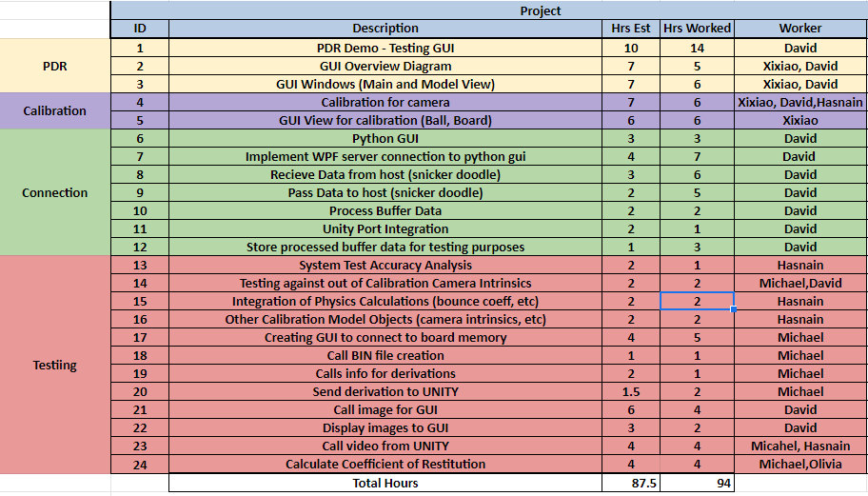
Task and Hours (GUI)

Slide 35
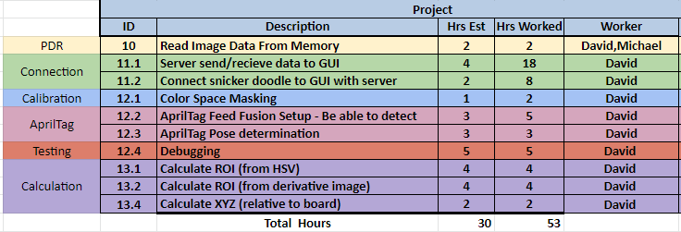
Task and Hours (CPU)

Slide 36
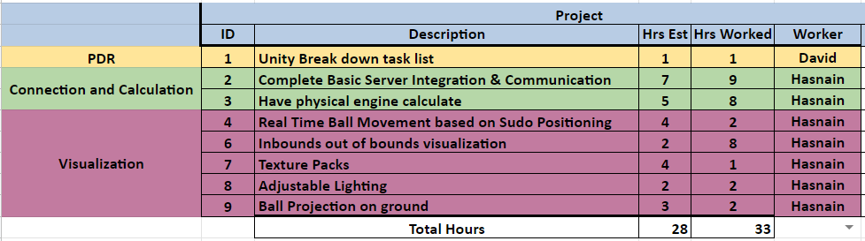
Task and Hours (Unity)

Slide 37
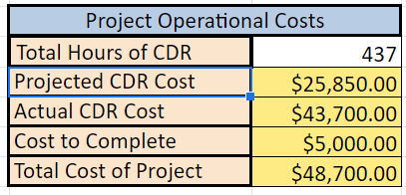
Projected Costs

Slide 38
Questions?

